Slide 1
How to acquire and play TimewinderTM
By sc64

Slide 2
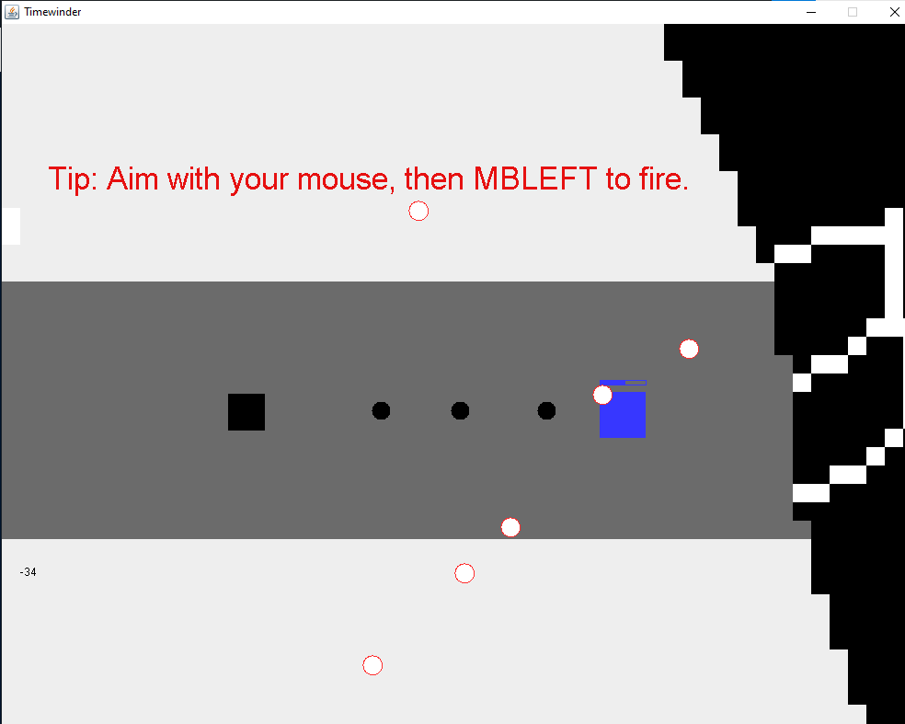
What is TimewinderTM?
You play as an adventurer that has a special ability: you can rewind time. With this ability, you get the advantage you need to beat the Dark Castle.
It is a linear adventure game where you have to defeat all the enemies to win.
You have to defeat all of the enemies in the room before you move on to the next room.

Slide 3
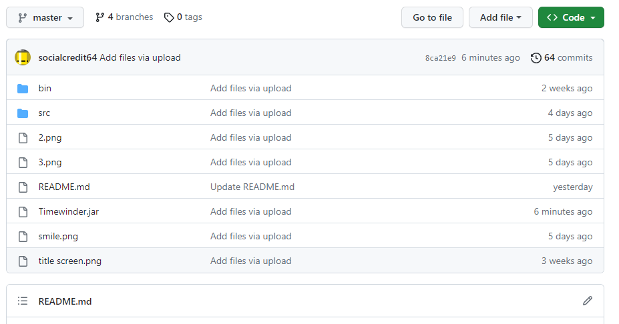
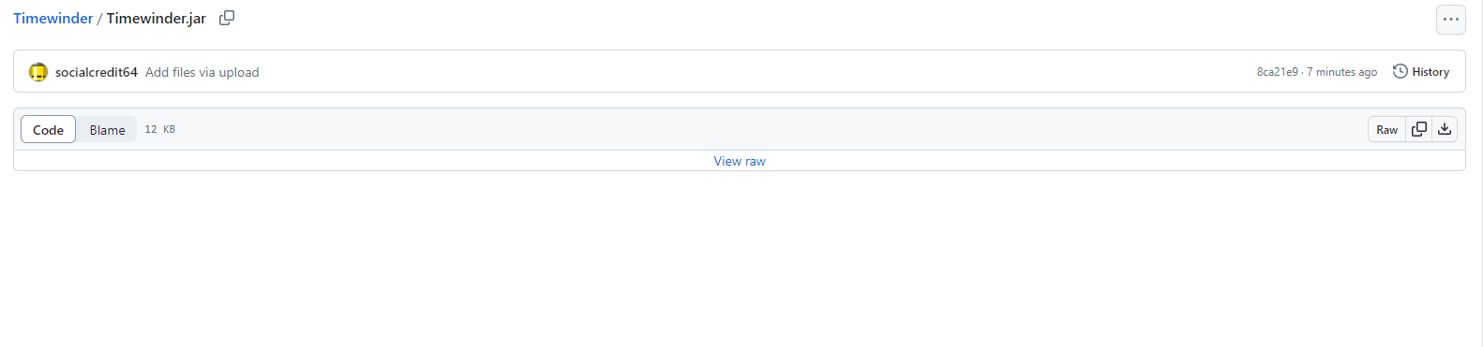
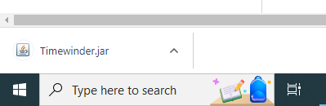
How to get a copy of TimewinderTM
Github: Step 1. Click on “Timewinder.jar”.
Step 2. When you’re in this screen, click download.
Step 3. If you’re using google chrome, find the file on the bottom of your screen.
Step 4. Click it and play!

Slide 4
How to play:
WASD- Controls the player’s movement.
MBLEFT- Aim with your mouse on the screen and fire.
The enemy fights back! If you get hit by the bullets, you lose HP. If it reaches 0, you don’t die. Instead, you go back in time and start over again with full health.
Warning: Challenging Game

Slide 5
Credits
Game: Li-En (Leon) Chen

Slide 6
FAQ
I can’t open the game - What’s going on?
You might need to install java on your computer.

